Slide 1
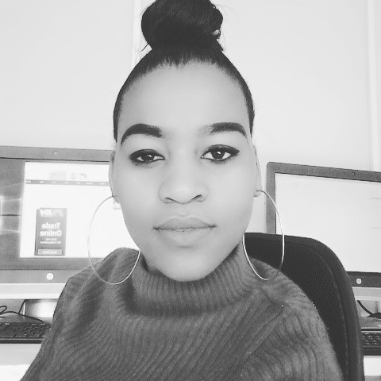
ABOUT POGISHO
I WAS BORN ON THE 08TH OF APRIL 1995
I AM THE FOURTH DAUGHTER OF JANE AND LUCAS

Slide 2
WHERE I AM FROM
I WAS BORN IN A SMALL PLACE CALLED GA MASEMOLA IN LIMPOPO PROVINCE .
I WAS RAISED BY BOTH MY PARENTS .

Slide 3
I WENT TO MOGAILE PRIMARY SCHOOL AND CONTINUE WITH STUDIES AT MOTUBATSE SENIOR SECONDARY SCHOOL UNTIL I FINISH MY MATRIC
I WENT TO EWC COLLEGE IN 2015 WERE I STUDIED INFORMATION TECHNOLOGY FOR THREE YEARS.

Slide 4
HOBBIES
READING BOOKS
WATCHING TV

Slide 5
WHAT I WANT TO ACHIEVE AT CODE TRIBE
I WANT TO GET MORE KNOWLEDGE ON HOW TO CREATE APPS KNOWING MORE ABOUT THEM,KNOWING ON HOW TO DEVELOP SOFTWARES AND ALSO KMOWING MORE ABOUT OTHER LANGUAGES

